Slide 1
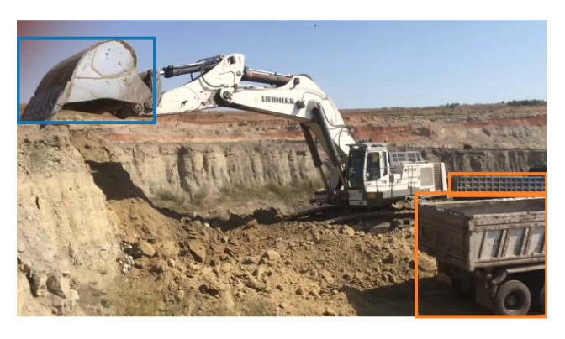
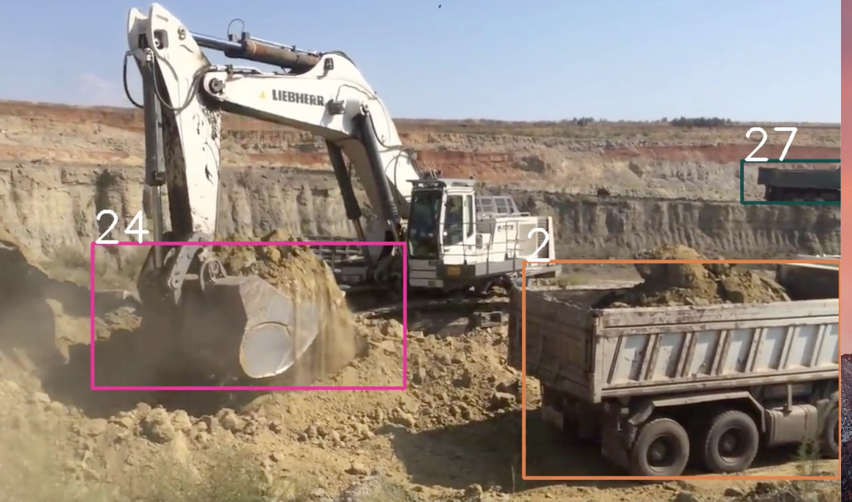
Video Track Flow
Label Objects for Training
Train a Model to Detect Objects
Track the Detection Results
Visualize the Rectangle and track id

Slide 2
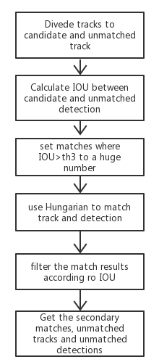
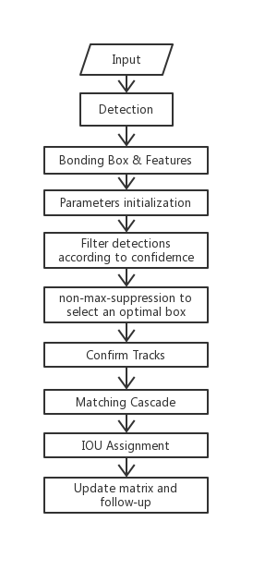
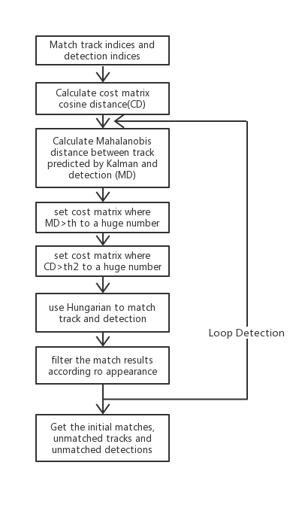
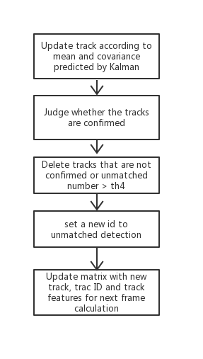
Deep Sort
Matching Cascade
IOU Assignment
Update matrix and
follow-up

Slide 3
Deep-SORT
SORT
Simple Online and Realtime Tracking
Deep-SORT
Track Handling and State Estimation
Tracking-by-detection
Assignment Problem
Matching Cascade
Deep Appearance Descriptor
Notes:
Sort is a pragmatic approach to multiple object tracking with a focus on simple, effective algorithms. In the deep-sort, the authors integrate appearance information to improve the performance of SORT. Due to this extension we are able to track objects through longer periods of occlusions, effectively reducing the number of identity switches.

Slide 4
NMS（non maximum suppression)
Sort the scores of all the boxes, select the highest one.
Traverse the remaining boxes, if the overlap area (IOU) with the current highest partition is greater than a certain threshold, we will delete the box.
Continue to select the highest score in the unprocessed box and repeat the above process.

Slide 5
Kalman Filter
t=0 the position of the car
What is KF： Optimal linear filter
Application：Trajectory prediction, State estimation
Formulation：
t=1 the predicted position of the car
predict
update
t=1 the measurement of the car
t=1 the Kalman position of the car
Notes:
F: state transition matrix 让不确定性在各个时刻之间传递
B: control matrix
P: prediction covariance matrix 衡量推测带来的不确定性
Q: noise
H: observation matrix
R: measurement covariance matrix
K: Kalman optimal estimate to correct the result 相信预测值还是测量值

Slide 6

State Estimation
Eight dimensional state space
(u, v, γ, h, x,˙ y,˙ γ, ˙ h˙)
Use Kalman filter to update tracks
Track Handling
Determine the start and end of a track
‘tentative’
‘confirmed’
‘deleted’
Character the state of the track at a certain moment
Time Threshold
occlusion
Notes:
State Estimation Characterize the state of the track at a certain moment.
Eight dimensional state space contains the bounding box center position (u, v), aspect ratio γ, height h, and their respective velocities in image coordinates.
Use a standard Kalman filter with constant velocity motion and linear observation model to update tracks.
Track Handling: Determine when the track ends and when a new track is generated.
For each track, there is a threshold a for recording the time from the last successful match to the current time. The track that is not matched for a long time is considered to have ended.
When matching, a new track may be generated for the detectors that have no matching success. However, since these detections may be some false alarms, the new generated track is marked with the state 'tentative' and then it is observed whether the consecutive matching is successful in the next consecutive frames (3 frames in the paper), if so It is considered to be a new track, marked as 'confirmed', otherwise it is considered a false track, and the status is marked as 'deleted'.

Slide 7
Hungarian
Track 1
Detection 1
What is Hungarian :
An algorithm for finding the maximum matching of bipartite graphs by augmented path.
Application :
Assignment problem
Track 2
Detection 2
Track 3
Detection 3
Track 4
Detection 4

Slide 8
Assignment Problem
Motion Match
Squared Mahalanobis Distance
Continuity of the motion
Appearance Match
Cosine Distance
Extract Feature by DNN
Combination
Weighted Sum
hyperparameter λ
Notes:
Assignment is the match between the currently active tracks ('tentative', 'confirmed') and the current detections.
Motion and appearance information are integrated to describe the degree of matching between the tracks and detections.
Use the (squared) Mahalanobis distance between predicted Kalman states and newly arrived measurements.
The detection can be filtered by the Mahalanobis distance in consideration of the continuity of the motion.
Appearance Match
Using Mahalanobis distance matching metric alone can lead to serious IDSwitch, especially the camera motion may cause it invalid, so appearance match is needed.
For each detection, including the detections in the track, extract the features by pre-trained deep neutral network. Use the minimum cosine distance as the appearance match between the detection and the track.
Combination
To build the association problem we combine both metrics using a weighted sum.
The influence of each metric on the combined association cost can be controlled through hyperparameter λ.

Slide 9
Deep Appearance Descriptor
Metric learning
Architecture
Two extracted features corresponding to the same identity are likely to be closer than features from different identities
Feature embedding to be trained offline
Notes:
By using simple nearest neighbor queries without additional metric learning, application requires a well-discriminating feature embedding to be trained offline, before the actual online tracking application.
Metric learning aims to construct an embedding where two extracted features corresponding to the same identity are likely to be closer than features from different identities.

Slide 10
Matching Cascade
Problem
Long time occluded objects cause probability mass spreads out
Track 1
Detection 1
Example
Track 2
Detection 2
CD>th
Detection tends to tracks that have lost more time due to smaller Mahalanobis distance
Track 3
Detection 3
Method
Track 4
Detection 4
A matching cascade that gives priority to more frequently seen objects
confirmed tracks
high-conf detections
CD : Appearance distance
MD : Motion distance
Notes:
When an object is occluded for a longer period of time, subsequent Kalman filter predictions increase the uncertainty associated with the object location. Consequently, probability mass spreads out in state space and the observation likelihood becomes less peaked.
When two tracks compete for the same detection, the Mahalanobis distance favors larger uncertainty, because it effectively reduces the distance in standard deviations of any detection towards the projected track mean.
马氏距离也可以定义为两个服从同一分布并且其协方差矩阵为Σ的随机变量之间的差异程度。

Slide 11
Track 1
Detection 1
Track 2
Detection 2
Track 3
Detection 3
Track 4
Detection 4
unconfirmed tracks
unmatched detections
Update matrix and
follow-up
IOU Assignment
Notes:
在匹配的最后阶段对unconfirmed和age=1的未匹配轨迹进行基于IoU的匹配。这可以缓解因为表观突变或者部分遮挡导致的较大变化这样做也有可能导致一些新产生的轨迹被连接到了一些旧的轨迹上。

Slide 12
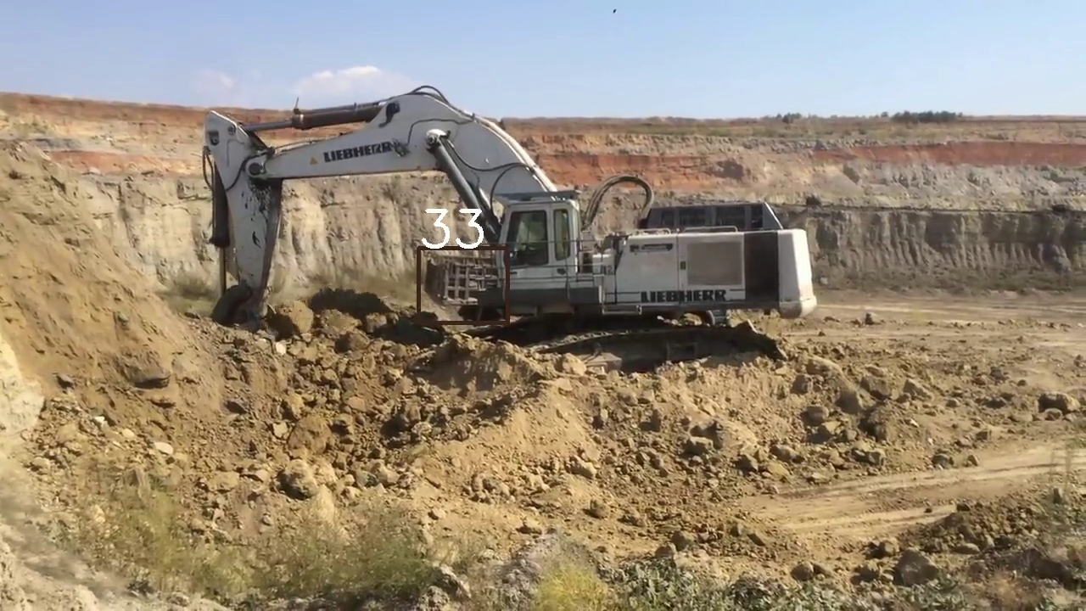
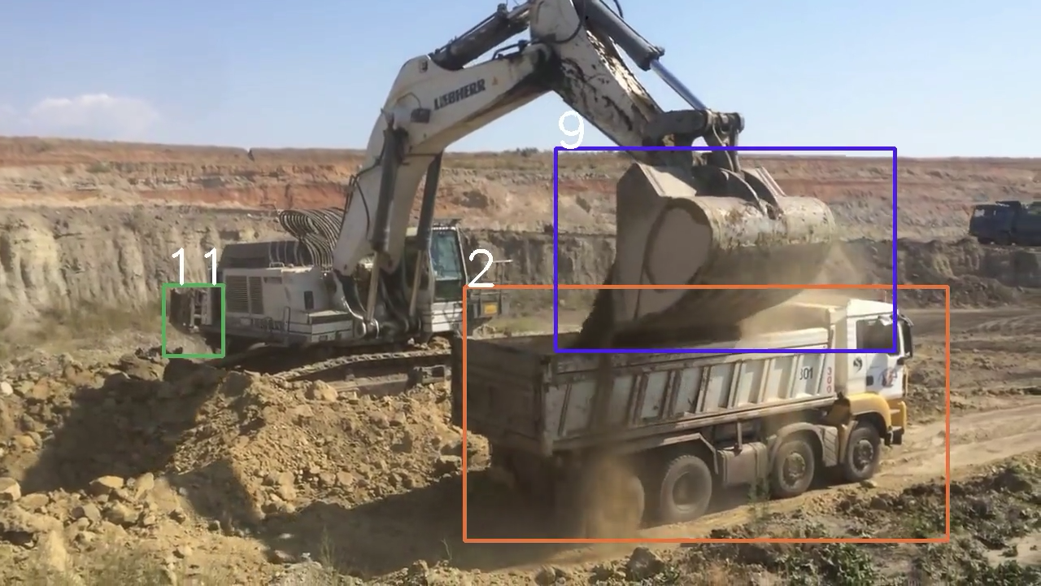
Result

